Slide 1
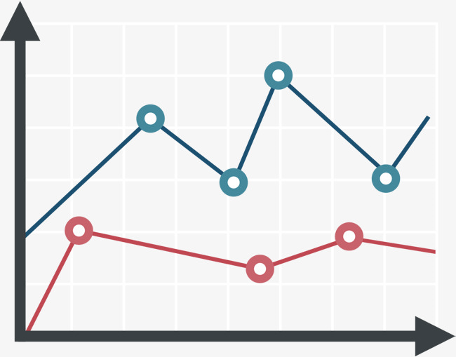
Main finding goes here, translated into plain English. Emphasize the important words. (feel free to add a focal graphic/picture below!)
Non-Cognitive Predictors of Student Success: A Predictive Validity Comparison Between Domestic and International Students
Non-Cognitive Predictors of Student Success: A Predictive Validity Comparison Between Domestic and International Students
Put Your Full Poster Title Here: And Include Your Subtitle if You Have One
Extra Tables & Figures
Extra Graphs
Extra Tables
Extra Figures
Extra nuance that you’re worried about leaving out
Author Name1, author2, author3, author4
INTRODUCTION
Who cares? Explain why your study matters in the fastest, most brutal way possible (feel free to add graphics!).
METHODS
How did you find this?
Collected [what] from [population]
How you tested it.
RESULTS
Graphs/table with essential results only
All the other data
DISCUSSION
“If this result actually generalized and I didn’t have to humbly disclaim the possibility of a thousand confounds and limitations, it would imply that….”
This is an APA mod of Mike Morrison’s Better Poster. Keep what works for you. Change what doesn’t.
Tips:
Keep font size as high above 28+ as possible.
Keep your summary tight. Think of it like “abstract+” with key figures only.
The more content you add here, the more cognitive load you add, and the more you’ll turn people off engaging.
Less content = more readers.
Now delete this text box. ☺
Notes:
Notes:
In Powerpoint, click View > Guides
Keep text within gutter guides.
Author list: Don’t split names onto two lines (e.g., “Jimmy [break] Smith”). If that happens, use a new line, unless you need the space. Bold the first names of anybody who’s presenting in person.
Intro/methods/result: Do not drop below font size 28, but if you have extra space, jack up the font size until the space is full.
Do not use color in the sidebars except in graphs/figures. It’ll pull attention from the center and slow interpretation for passersby.

